Slide 1
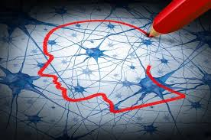
Psychophysiology in sports

